Slide 1
Software Project Management resource allocation
Dr. D Evangelin geetha
Associate professor
Department of master of computer applications
Ramaiak institute of technology
Bangalore - 560054

Slide 2
Learning objectives
Identify the resources required for a project
Make the demand for resources more even throughout the life of a project
Produce a work plan and resource schedule

Slide 3
introduction
Result of resource allocation
  Activity schedule
  Resource schedule
  Cost schedule

Slide 4
Nature of resources
Labour
Equipment
Materials
Space
Services
Time
Money

Slide 5
Identifying resource requirements
Resource requirements list
  Stage - All
  Activity – Project Manager
  Days - 104 Days
  Quantity - 1
  Notes
  E.g

Slide 6
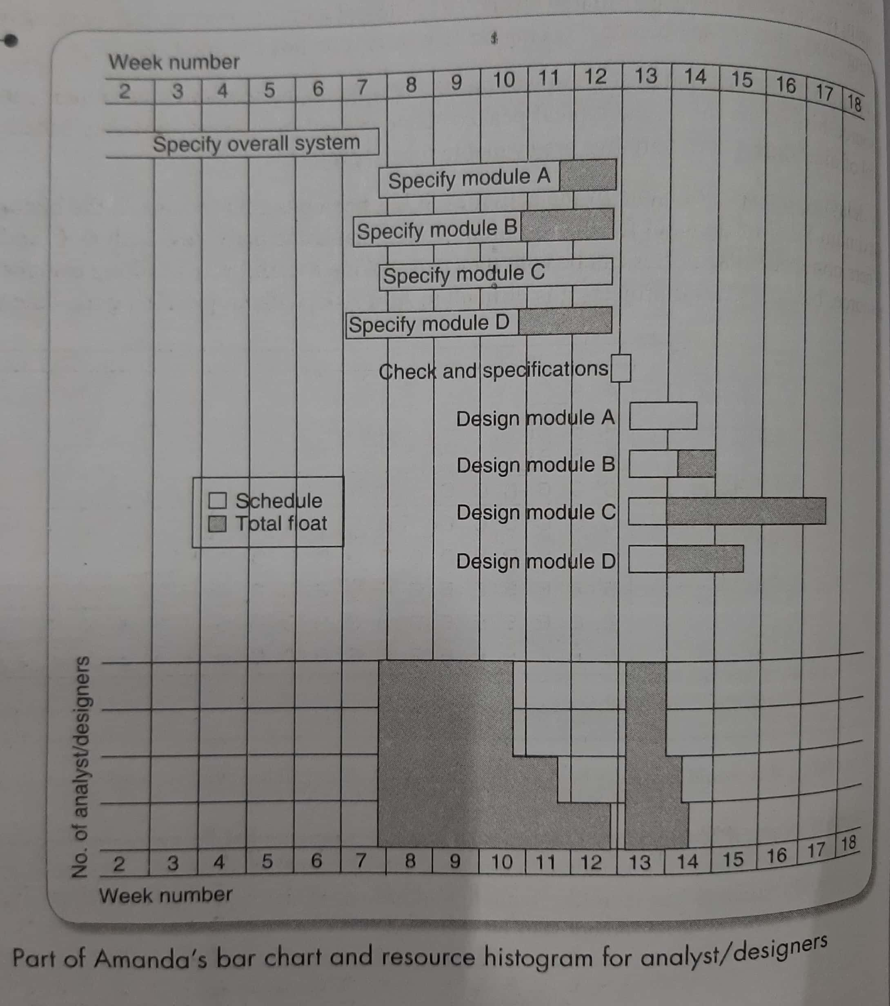

Slide 7
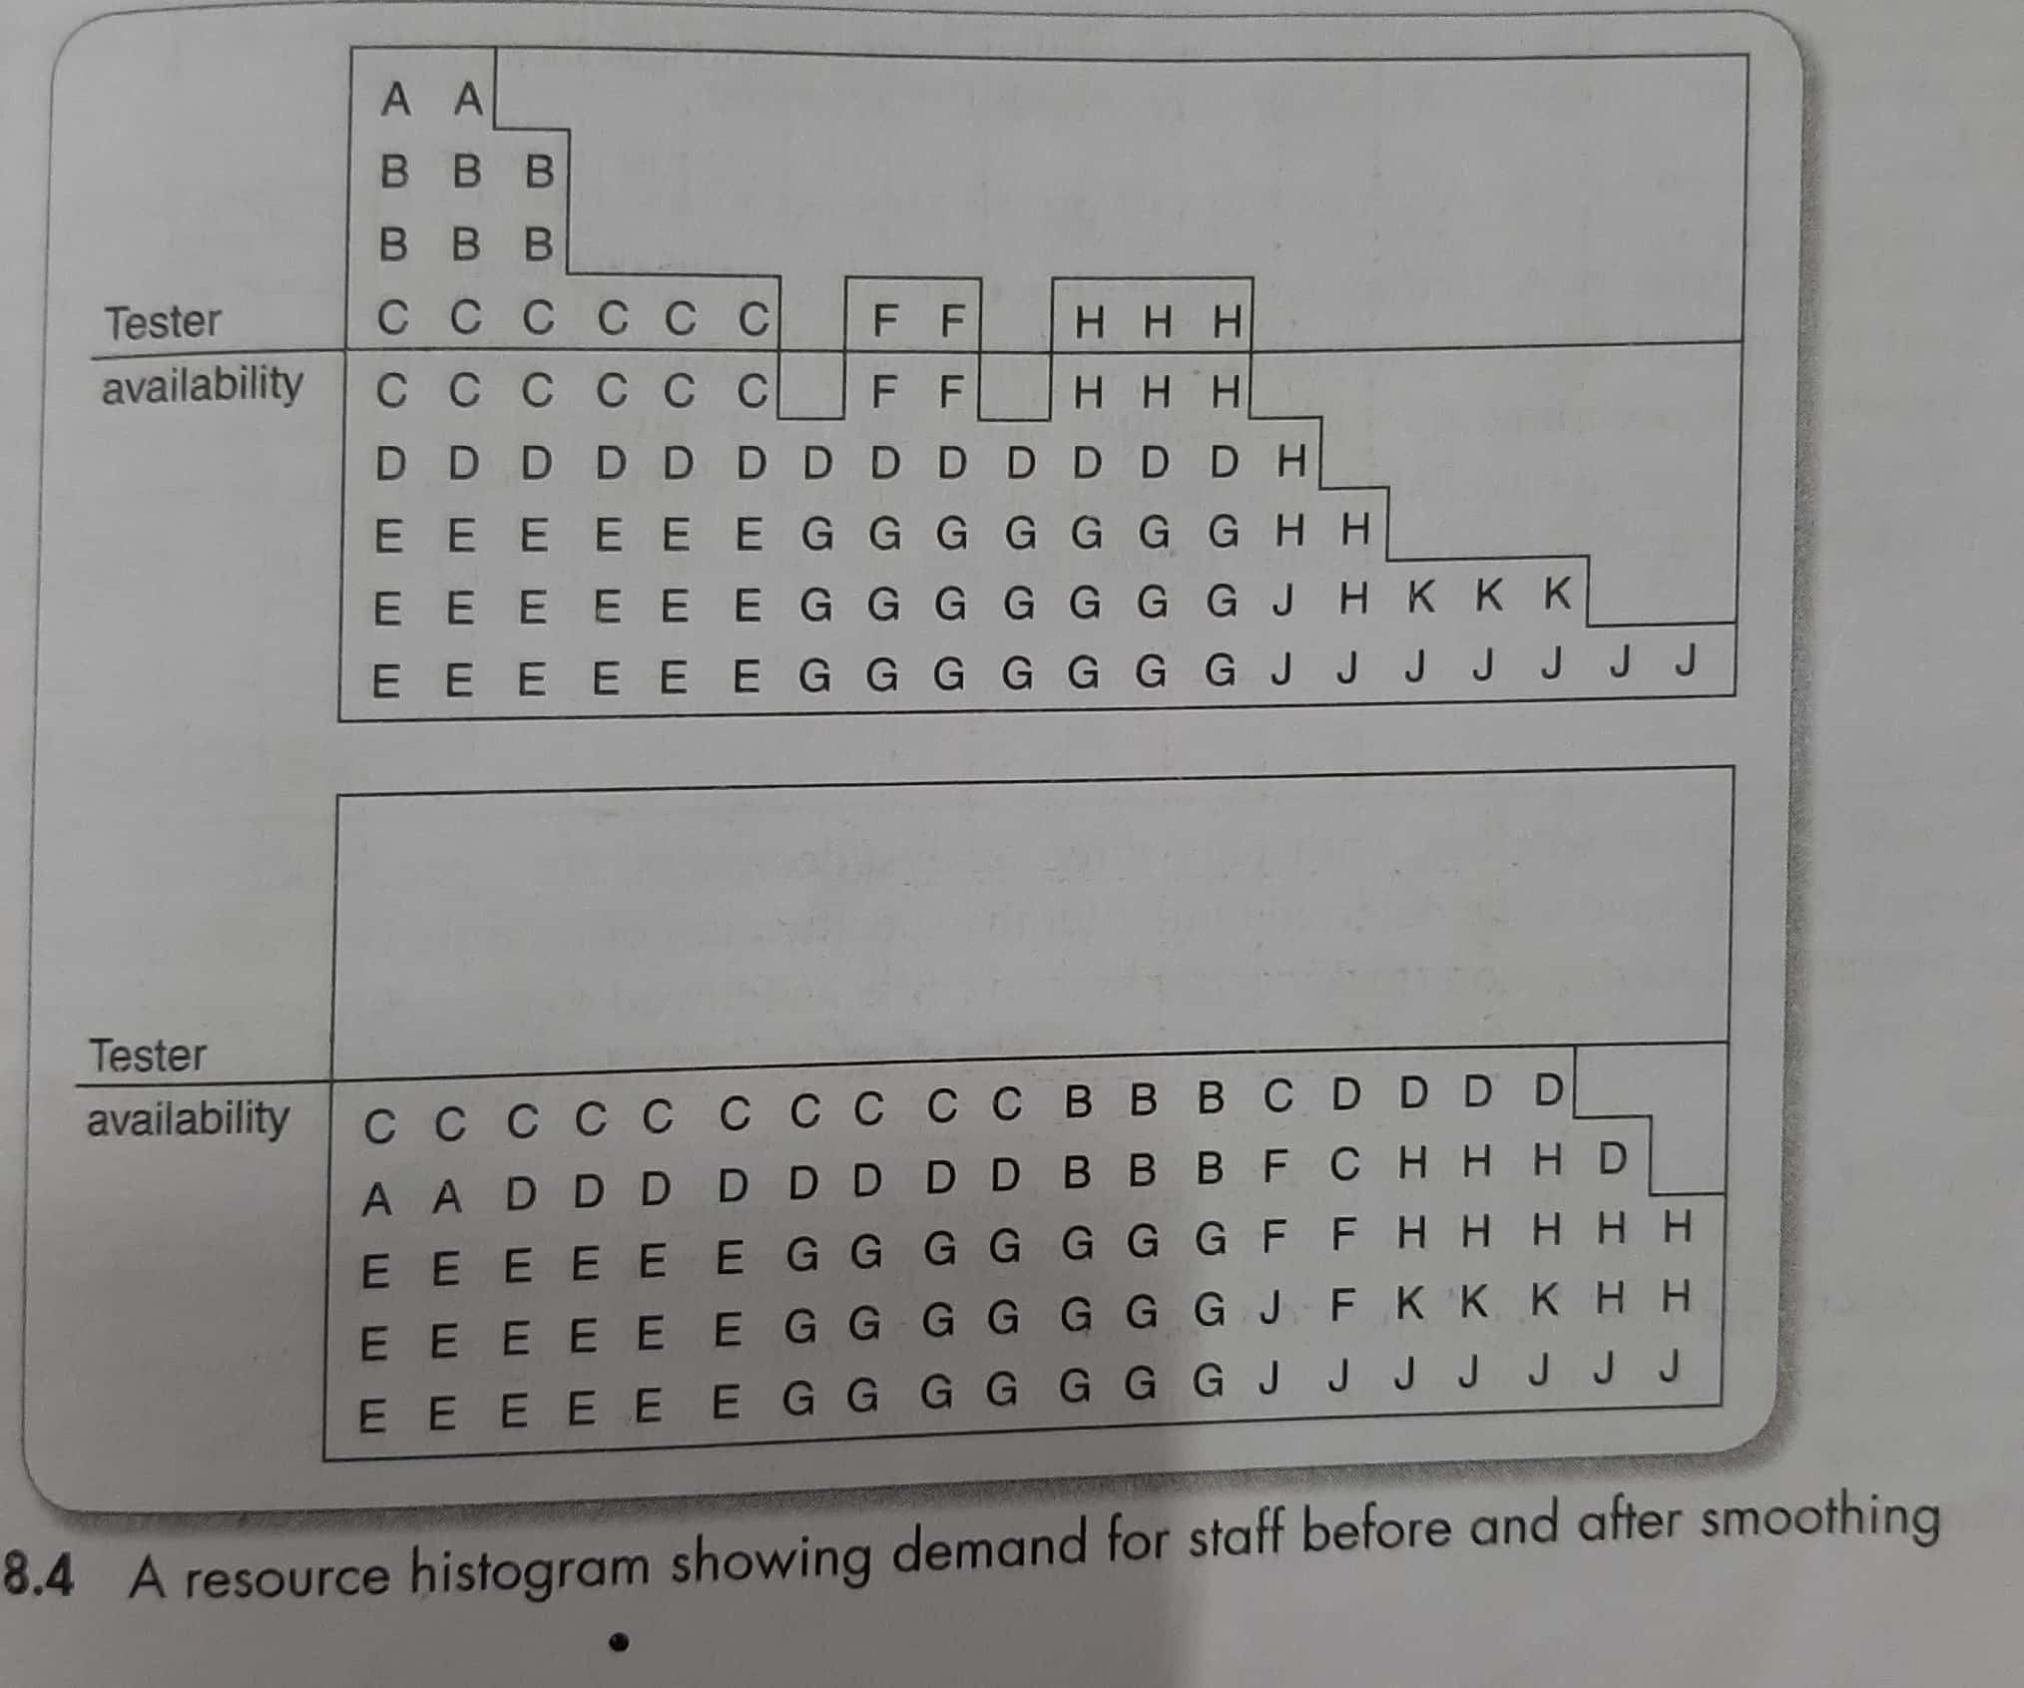

Slide 8
Scheduling resources
Ordered list priority
  Shortest critical activity
  Critical activities
  Shortest non-critical activities
  Non-critical activity with least float
  Non-critical activities

Slide 9
Creating critical paths

Slide 10
Counting the cost

Slide 11
Being specific
Availability
Criticality
Risk
Training
Team building

Slide 12
Publishing the resource schedule

Slide 13
Cost schedules
Staff costs
Overheads
Usage charges

Slide 14
Scheduling sequence

Slide 15
example
Draw an activity network for the activities below. Identify critical path.
Activity | Duration (Days) | Depends on | Resource type
A | 2 | - | SA
B | 10 | A | SD
C | 2 | A | SD
D | 2 | C | SC
E | 3 | C | SC
F | 2 | C | SC
G | 4 | B, D, E, F | SA
SA – systems analyst SD-systems designer SC – Software coder
Assume that there is only one systems designer, 1 systems analyst and 2 software coder
i) Schedule the project and show your results in the form of a bar chart and resource histogram.
ii) Identify the best way of revising the plan to remove resource clashes.

